Slide 1
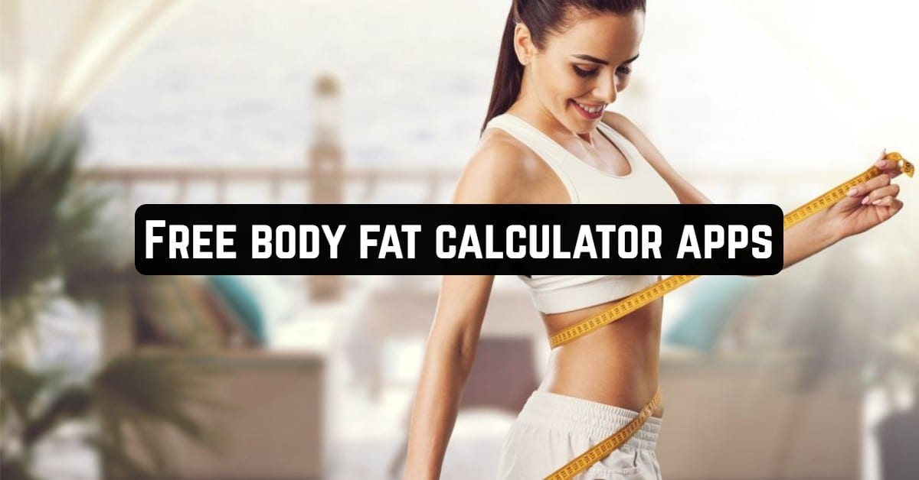
Body Fat Prediction

Slide 2
PROJECT TITLE
BODY FAT PREDICTION
CREATED BY :-
SANTOSH SAHU - U19CN378

Slide 3
Abstract.
Aim And Objectives.
Methods.
Technologies Requirements.
Calculations.
Implementation.
Installation Process.
Result.
Result ScreenShots.
Conclusion.
AGENDA

Slide 4
The Body Fat Prediction is an Android Application which is basically based on Machine learning and Data Science. BFP calculate the fat percentage, body mass index and weight to height ratio in the body. Excess of body fat leads to serious medical diseases, such as cancer, heart disease, and diabete. To away this diseases reduction of fat is very important. By knowing our fat weight, helps in fat reduction. Although there are several ways to measure the body fat percentage (BFP), the methods are often associated with hassle and high costs. By research from existing approaches, this study proposes new intelligent hybrid approaches to obtain a small number of explanatory variables, and the proposed forecasting models are able to predict the BFP. The proposed hybrid models consist of multiple regression, artificial neural network (ANN), multivariate adaptive regression splines (MARS), and support vector regression (SVR) techniques which used to predict discrete values. A real dataset was used to demonstrate the development of the proposed hybrid models. The Prediction results revealed that the proposed hybrid schemes outperformed the typical, single-stage forecasting models. By using and then giving inputs to this application all can know there fat percentage and body mass, there can reduse fat by taking low fat foods to get a best health.
ABSTRACT

Slide 5
This study was to develop a new prediction model for body fat estimation in working men and women, accounting for a wide range of ages and obesity levels and variation in individual anthropometry.
AIM
and
OBJECTIVES
To calculate the body fat percentage, body mass index and weight to hight ratio.
To help people to maintain their fat from the body.
People should know their measures for a good health.
To avoid several diseases.

Slide 6
This study included 228 adults between the ages of 21 and 70, with BMI between 18.5 and 40.0 kg m−2. The study population was split into training (n = 163) and validation (n = 65) groups, which were used to develop and validate the prediction models. The models were developed on the training group using a backwards stepwise regression analysis, with the initial predictors including age, BMI, and several anthropometric and skinfold measurements.
METHODS

Slide 7
TECHNOLOGY
REQUIREMENTS

Slide 8
Equation (1):
Female BFP = 225.43 – Age*12.42 + (Age2)*0.140 – BMI*14.43 + (BMI2)*0.266 + (Age*BMI)*0.893 – (Age*BMI2)*0.0154 – (Age2*BMI)*0.0100 + (Age2*BMI2)*0.000174 + (Waist circumference)*0.129 – (Neck thickness)*6.44 – (Vertical abdominal skinfold)*1.83 + (Thigh skinfold)*1.61
CALCULATIONS
Equation (2):
Male BFP = 22.76 + Age2*0.00168 – BMI*0.700 + (BMI2)*0.0139 – (Age2*BMI)*0.000233 + (Age2*BMI2)*0.0000072 + (Hip circumference)*0.288 – (Mid-thigh circumference)*0.401 – (Neck
thickness)*4.94 + (Subscapular skinfold)*2.22 + (Vertical abdominal skinfold)*1.60 + (Thigh skinfold)*1.69

Slide 9
Step-1:
INSTALLATION
PROCESS

Slide 10
I
IMPLEMENTATION

Slide 11
The final statistical regression models included age, BMI, anthropometric measures, and skinfold measures with significant effects following the stepwise process. The models predicted body fat percentage in the testing group with average errors of less than 0.10% body fat in males and females, while the four previously existing methods (Durnin, Hodgdon, Jackson, and Woolcott) significantly underestimated or overestimated body fat in both genders, with errors ranging between 2% and 10%.
RESULTS

Slide 12
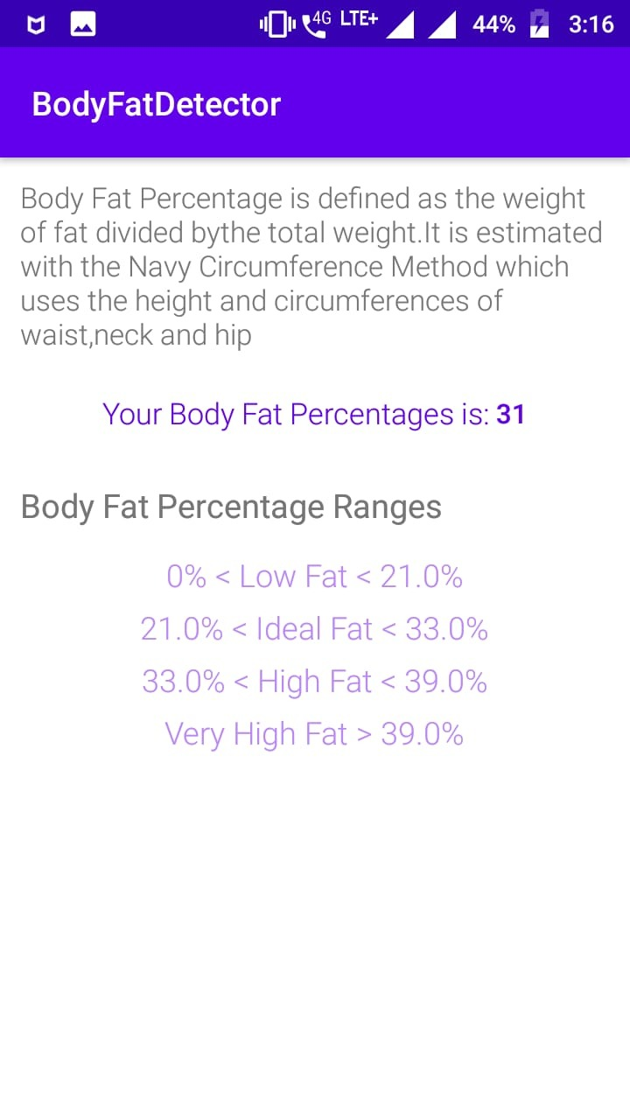
RESULT
SCREENSHOTS

Slide 13
The final models included hand thickness, and the female model was dependent on waist circumference and two of the skinfold measures, while the male model used hip and thigh circumferences, along with three skinfold measures. By including the skinfold measurements separately, instead of only as sums like previous models have done, these models can account for the different relative contributions of each site to total body fat.
CONCLUSION

